Slide 1
Personal CRM
By Jason Chen, Blake Hoff, Michael Wang
CSE 111 Database Systems
Phase 3

Slide 2
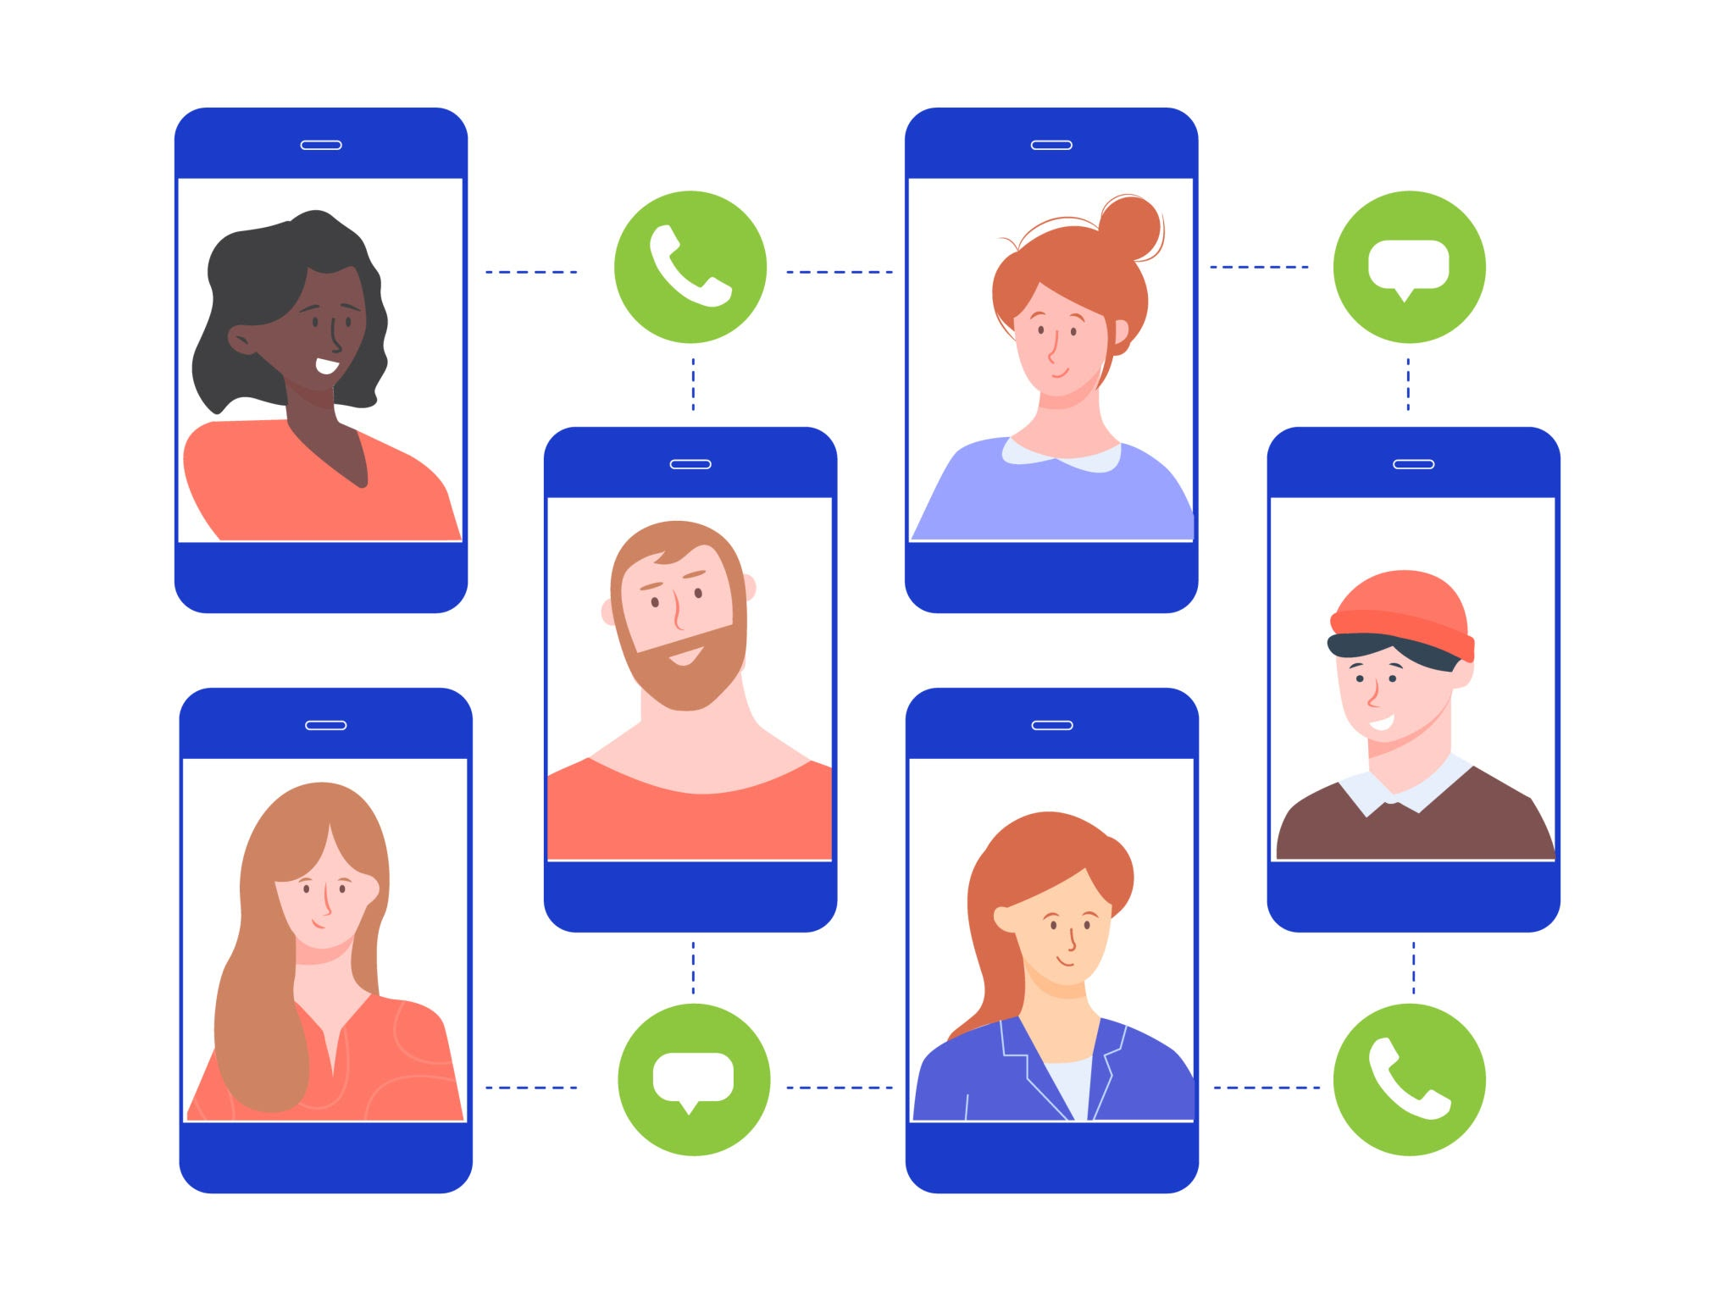
System Description - Personal CRM
We built a local web application for containing the information you have about your friends and anyone you know.
Our app can be used to remember how you met someone, and other facts about them like their birthday. You can add anything you want to remember about them.
Notes:
Michael

Slide 3
Use Case Description
Add Contact - User should be able to add contacts to their contact list
View/Edit Contact - User can view their contacts in the contact list, and edit any attributes from the list.
Delete Contact - User can delete any of their contacts from the contact list.
Notes:
blake

Slide 4
Use Case #1 - Add Person, Reminder, Or Note
Participating Actors: Owner of Personal CRM, person of interest
Event Flow:
Owner navigates to the personal CRM person page
Clicks the button for add new person, reminder or note
Displays empty contact information text fields with address, name, birthday etc, or due date and reminder name, or note name
Owner enters the information for all of the fields
Owner saves the information
System adds stored information to the database
Exit Conditions: New contact/reminder/note has been added to the database
Notes:
blake

Slide 5
Use Case #2 - View/Edit Person, Reminder or Note
Participating Actors: Owner of Personal CRM, person of interest
Event Flow:
Owner navigates to the personal CRM people page and views all of their contacts, reminders, and notes
Clicks the button for edit contact, reminder, or note
Displays contact information text fields with address, name, birthday etc.
Owner can edit any of the information in the fields
Owner saves the contact information
System saves new information to the database
Exit Conditions: Contact/Reminder/Note has been edited/viewed and updated in the database
Notes:
blake

Slide 6
Use Case #3 - Delete Person, Reminder, or Note
Participating Actors: Owner of Personal CRM, person of interest
Event Flow:
Owner navigates to the personal CRM people page and views all of their contacts, and their associated reminders/notes
Owner clicks the button for delete person, reminder or note
Owner clicks yes, when database asks, “Are you sure”
System removes contact information from the database
Exit Conditions: Person/reminder/note has been removed from the database
Notes:
blake

Slide 7
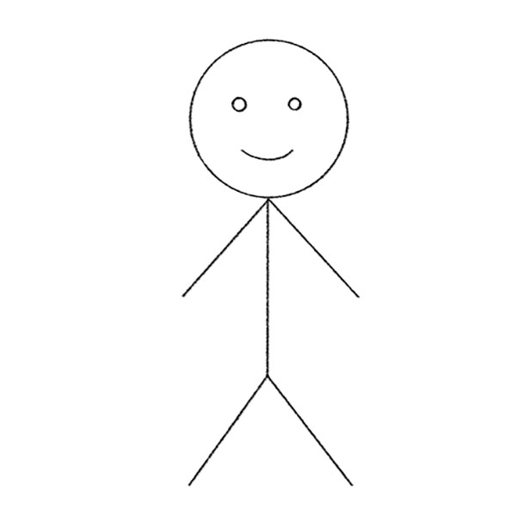
UML Use Case Diagram(For Person)
Add New Contact
Owner of Personal CRM
Edit(Change contact info)
View Contacts Page
Saves new database
Delete Contact

Slide 8
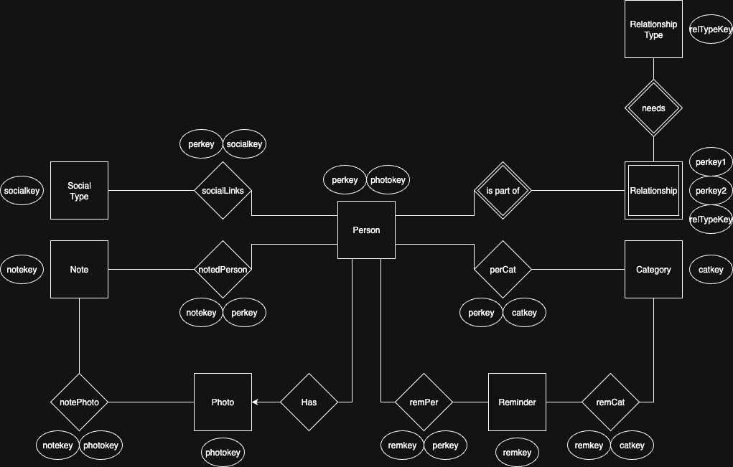
E/R Diagram

Slide 9
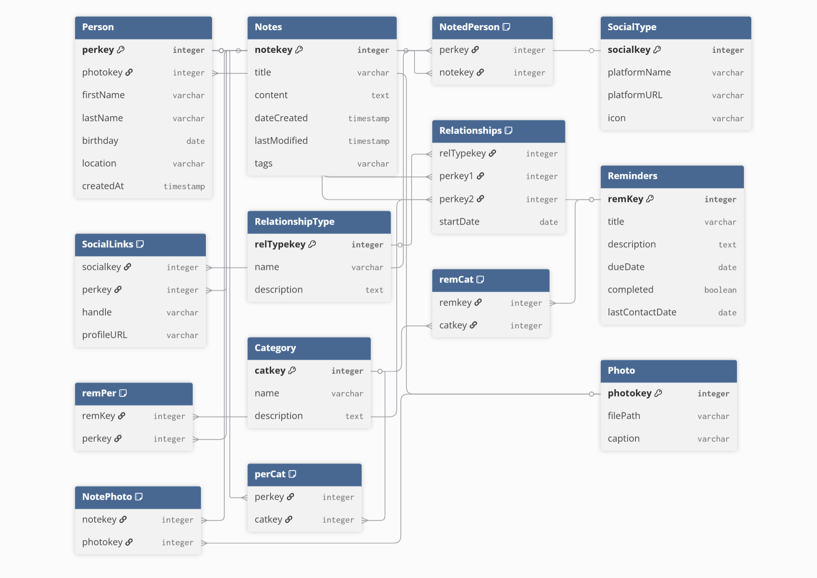

Slide 10
E/R Diagram Converted to Relational Schema(Tables)
Tables
Person(perkey, photokey, firstName, lastName, birthday, location, createdAt)
Notes(notekey, title, content, dateCreated, lastModified, tags)
NotedPerson(perkey, notekey)
SocialType(socialkey, platformName, platformURL, icon)
SocialLinks(socialkey, perkey, handle, profileURL)
Relationships(relTypekey, perkey1, perkey2, startDate)
RelationshipType(relTypekey, name, description)
Reminders(remKey, title, description, dueDate, completed, lastContactDate)
remPer(remKey,perkey)
remCat(remkey, catkey)
Category(catkey, name, description)
Photo(photokey, filePath, caption)
NotePhoto(notekey, photokey)
perCat(perkey, catkey)

Slide 11
Implementation Details
Database Layer
Used SQLite as the primary database
Designed relational schema with tables for: Persons, Notes, Reminders, Relationships, Junction tables
Backend Layer
Implemented using Flask.
REST API routes for: Creating, reading, updating, deleting in Persons, Notes, and Reminders tables
Frontend Layer
Built with React + Vite for modularity and easier development
Uses React Hooks like useState, useEffect to manage statuses and states

